Slide 1


Slide 2

Blinkit Sales Data Analysis

Slide 3
Your Name: Arpita chakraborty
College Name: Guru Nanak Institute of Technology
Department: Master of Computer Applications
Semester: 3rd Semester
🎓Internship Under Classroom
📞 Contact Us
📱 Phone: 8981838547
🌐 Website: https://classroomtech.in
🔗 LinkedIn: https://www.linkedin.com/company/classroom-tech/
⌚Duration: 3 months (April 1, 2025 – June 30, 2025)

Slide 4
⭐Acknowledgement
Thanking my guide, Mr. Satyaki Das , for their invaluable support and guidance throughout this project. I would also like to express my gratitude to Classroom Tech for providing me with this opportunity and the necessary resources. Finally, I thank my family and friends for their constant encouragement.

Slide 5
💻Table of Contents
1️⃣Title Slide: Page 1
2️⃣Acknowledgement: Page 2
3️⃣Table of Contents: Page 3
4️⃣Objective / Problem Statement: Page 4
5️⃣Dataset Overview: Page 5-6
6️⃣Tools Used: Page 7
7️⃣Methodology: Page 8
8️⃣Detailed Slide for Each Visualization: Page 11-32
9️⃣Key Findings: Page 33
🔟Conclusion: Page 34
1️⃣1️⃣References: Page 35
1️⃣2️⃣ Github Repository Link: Page 36
1️⃣3️⃣Thank You!: Page 37

Slide 6
💡Objective / Problem Statement
1️⃣Goal of the Project:
The primary goal of this project was to analyze Blinkit's sales data to derive actionable insights into customer behavior, product performance, delivery efficiency, and campaign effectiveness.
2️⃣Questions Addressed:
This analysis aimed to answer questions such as:
What are the overall revenue and customer lifetime value?
How are customers segmented, and what is the distribution of these segments?
Which pincodes generate the most orders?
What are the most frequently ordered products and categories?
How efficient is the delivery process, and what factors influence delivery time?
Which marketing campaigns are most effective in terms of revenue and ROAS?

Slide 7
🗂️Dataset Overview
🗂️ Dataset Name: Blinkit Sales Data
Source: Kaggle
Description: A comprehensive dataset containing various aspects of Blinkit's operations, including sales, customer information, product details, campaign performance, delivery metrics, and feedback.
⌨️ Key Tables and Columns Used for Analysis:
1️⃣Overall Metrics (KPIs):
Total Revenue, Total Customer Lifetime Value, Average Order Value, Total Campaign Revenue
2️⃣Customer Details Table:
Rows: 18 (sample shown)
Columns: 3 (customer_id, customer_name, email)
Purpose: Customer identification and contact information.
3️⃣Customer Lifetime Value Table:
Rows: 14 (sample shown)
Columns: 4 (customer_id, customer_name, Sum of avg_order_value,
Total Customer Lifetime Value)
Purpose: Analyzing customer value and spending patterns.

Slide 8
4️⃣Order Quantity Per Product Category Table:
Rows: 9
Columns: 2 (category, Count of quantity)
Purpose: Understanding product category performance by volume.
5️⃣All Campaigns Table:
Rows: 14 (sample shown)
Columns: 4 (campaign_id, campaign_name, Sum of spend, Sum of revenue_generated)
Purpose: Evaluating marketing campaign effectiveness.
6️⃣Feedback Details Table:
Rows: 10 (sample shown)
Columns: 5 (feedback_id, order_id, sentiment, feedback_category, rating)
Purpose: Analyzing customer sentiment and feedback categories.
7️⃣Total Sales Revenue per Product Table:
Rows: 10
Columns: 2 (product_name, Total Sales Revenue per Product)
Purpose: Tracking revenue generated by each product.
8️⃣Customers Orders by Store ID Table:
Rows: 11 (sample shown)
Columns: 3 (store_id, order_id, Sum of order_total)
Purpose: Understanding order distribution across different stores.
9️⃣Product Category Ratings Table:
Rows: 4 (sample shown)
Columns: 3 (category, Average Customer Rating Emoji, Rating)
Purpose: Evaluating customer satisfaction with product categories.

Slide 9
🛠️Tools Used
1️⃣Power BI:
Utilized for data cleaning, transformation, and modeling.
Developed interactive dashboards and reports for insightful data visualization.
Enabled dynamic filtering and drill-down capabilities for deeper analysis.
2️⃣GitHub for Repository Management:
Used for version control of project files, including Power BI reports and documentation.
Facilitated collaboration and ensured tracking of all changes made during the analysis process.

Slide 10
📋Methodology
1️⃣Data Acquisition:
Obtained the Blinkit Sales Data from Kaggle.
2️⃣Data Cleaning & Transformation:
Missing Values Handling: Identified and addressed missing data points, employing appropriate strategies (e.g., imputation) to maintain data quality.
Outlier Removal: Analyzed data for outliers that could skew results and applied techniques to mitigate their impact, ensuring robust analysis.
3️⃣Visualization Creation:
Key Performance Indicators (KPIs): Designed prominent cards to display critical business metrics like Total Revenue, Customer Lifetime Value, and Average Order Value for immediate insights.
Distribution Analysis: Utilized pie charts and bar charts to illustrate the distribution of customer segments and the concentration of orders across different pincodes.

Slide 11
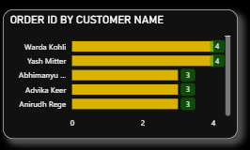
Purpose
The visual shows a bar chart representing the number of orders (Order IDs) placed by each customer. It aims to:
Identify which customers have placed the highest number of orders.
Provide a quick comparison among customers for sales analysis or CRM targeting.
1. ORDER ID BY CUSTOMER NAME

Slide 12
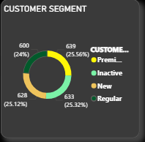
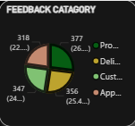
2. Customer segment & feedback category
Purpose
This donut chart visualizes the distribution of customers by segment type. Its main aims are:
To show how customers are divided among Premium, Inactive, New, and Regular segments.
To assist in customer base analysis for targeted marketing and retention strategies.
Purpose
This helps the organization identify which areas receive the most feedback, allowing them to priorities improvements or maintain strong performing areas accordingly. Let me know if you also want insights from this data for your upcoming reports or Power BI summaries today.

Slide 13

3. Most Frequent Product Name
Information
Label Displayed: Baby Food
Context: It is indicated as the “Most Frequent Product.”

Slide 14


Purpose
These two KPI cards display:
Average Order Value ($1K)
Shows the average amount spent per order.
Helps in assessing customer spending behaviour per transaction.
Total Sales Revenue ($1.42M)
Displays the total revenue generated from all sales.
Indicates overall business performance and sales effectiveness.
3.Retention Rate (68.7%)
Shows the percentage of customers retained over a period.
Used to measure customer loyalty and satisfaction.
4.Total Customer Lifetime Value (₹ 3.08M)
Shows the total revenue expected from all customers over their relationship with the business.
Used to evaluate customer value contribution for strategic decisions.
4. Total Revenue , Total Customer Lifetime Value,
Average Order Value, Retention Rate

Slide 15
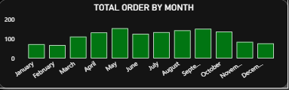
Purpose
This bar chart shows the total number of orders placed each month. Its key aims are:
To analyze order trends over months.
To identify seasonal patterns or sales fluctuations for planning inventory, marketing, and operations.
5. Total Orders by Month

Slide 16
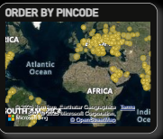
🎯 Purpose of this map:
To visualize order distribution by pin code/location.
Helps identify:
Regions with high or low order density
Geographic trends in customer orders and delivery coverage
Areas for targeted marketing or logistics optimization
6. Orders By Pin code

Slide 17
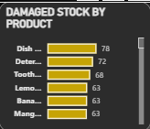
✅ Purpose: This "Damaged Stock by Product" bar chart is used to:
Display damaged stock quantities by product – Shows how many units of each product are damaged.
Identify products with high damage rates – Helps prioritize which products (e.g. Dish products, Detergent) need better handling, packaging, or storage improvements.
Support inventory and operational decisions – Useful for reducing wastage, improving quality control, and managing costs in warehouse and supply chain operations.
7. Damage Stock By Product
7. Damage Stock By Product

Slide 18




8. Total Delivery Time, ROAS_FI, Total Orders And total revenue
8. Total Delivery Time, ROAS_FI, Total Orders And total revenue
Total ROAS (Return On Ad Spend) – 197.27%
For every 1 unit spent on advertising, you are earning approximately 1.97 units in return.
This indicates efficient ad spending and positive profitability from ads.
Total Orders – 5000
Shows a high volume of orders processed.
Indicates good market traction and product/service demand.
Total Revenue Generated – 32.19M
The business has generated a total revenue of 32.19 million units (likely currency).
This reflects strong financial performance aligned with the order volume and ROAS.
Total Delivery Time – 311.
This indicates operational workload and timeline, which can be analysed further for efficiency improvements.
Insights :

Slide 19
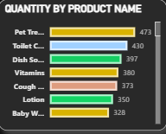
✅ Purpose: This "Quantity by Product Name" bar chart is used to:
Visualize product quantities – Shows how many units are associated with each product.
Identify top products – Helps quickly see which products (e.g. Pet Treats, Toilet Cleaner) have the highest quantities.
Support inventory and sales decisions – Useful for stock management, sales planning, or procurement analysis to know which items need replenishment or promotion.
9. Order Quantity Per Product

Slide 20
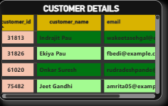
✅ Purpose:
To display customer data including:
Customer_id (unique identifier)
customer_name (full name)
email (contact email)
Such a table is used in CRM systems, dashboards, or databases to:
Manage customer records
View, edit, or update contact details
Analyze customer base for sales, support, or marketing decisions.
.
10. Customer Details Table

Slide 21
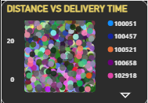
Purpose
✅ Primary Purpose: To analyze the relationship between delivery distance and delivery time.
✅ Why it is used:
To understand if greater distances lead to longer delivery times (check for correlation).
To identify inconsistencies where short distances still take long times, highlighting potential operational inefficiencies.
To compare performance across different categories or regions (shown by different colors in legend).
✅ Business Utility:
Helps in route optimization and resource planning.
Supports decisions to improve delivery efficiency, customer satisfaction, and cost control.
11. Delivery Time vs Distance (Scatter Plot)

Slide 22
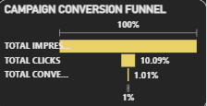
Insights :
1️⃣Shows a sharp drop from 29.49M impressions to 0.30M conversions, with a conversion rate of just 0.9%.
2️⃣Despite low conversions, revenue generated is ₹32.19M — implies high value per conversion.
3️⃣Indicates strong monetization but weak conversion rate, suggesting room to optimize ad targeting or landing pages.
4️⃣A/B testing or improved CTA could help increase click-to-conversion
12. Campaign Conversion Funnel

Slide 23
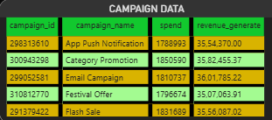
Insights :
1️⃣Total Spend: ₹1.63 Cr | Revenue: ₹3.22 Cr — a strong 1.97x return.
2️⃣The campaigns are performing efficiently, nearly doubling the investment.
3️⃣This suggests well-optimized targeting and product-market fit.
4️⃣Continued investment in top-performing campaigns could further boost ROI.
📊13. All Campaigns

Slide 24

Insights :
1️⃣Orders peaked in May, then gradually declined through December.
2️⃣The trend indicates strong mid-year demand, possibly due to seasonal promotions or holidays.
3️⃣The drop in later months may signal reduced marketing push or changing consumer behavior.
4️⃣Planning future campaigns around peak months could maximize order volume
📈14. Order of month

Slide 25
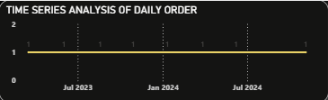
✅ Primary Purpose: To track and analyze the trend of daily orders over time.
✅ Why it is used:
To observe patterns, growth, or decline in orders on a daily basis.
To identify seasonality or peak order periods for strategic planning.
To monitor operational performance and adjust marketing or inventory based on order trends.
💰 15. Total Revenue by Product Category

Slide 26
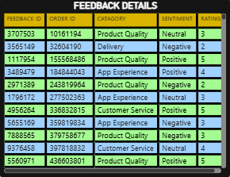
1️⃣Insight:
Mixed sentiments with ratings ranging from 1 to 5 across categories like “packaging issue” and “delayed delivery.
”Negative feedback is linked primarily to service and logistics.
2️⃣Observation:
Prioritize improvements in packaging and delivery speed to enhance customer satisfaction and reduce churn.
🗣️ 16. Feedback Details
🗣️ 22. Feedback Details

Slide 27
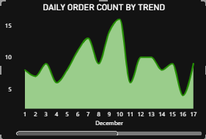
📈 25. Daily Order Count Trend (December)
📈 17. Daily Order Count Trend (December)
1️⃣Insight:
Highest spike observed on December 7; orders fluctuate daily.
Order volume shows unstable demand across the month.
2️⃣Observation:
Promote consistent customer engagement during low-activity periods to maintain order flow.

Slide 28
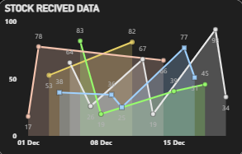
📦 18. Stock Received Data
1️⃣Insight:
Products show monthly fluctuations with peaks in April, May, and August.
Consistent replenishment patterns suggest strategic alignment with seasonal or promotional cycles.
2️⃣Observation:
Refining inventory planning around peak months can prevent overstock or understock issues.

Slide 29
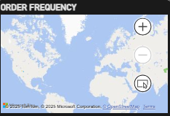
🌍 19. Order Frequency
🌍 29. Order Frequency
Insight
🔷 What it shows:
A map visualizing order frequencies by geographical location.
🔷 Current Observation:
Very few data points are visible, indicating:
Low order density across mapped regions, or
Incomplete geolocation data for orders.

Slide 30
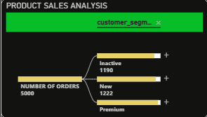
🌳 20. Decomposition Tree – Product Sales
1️⃣Insight:
Total revenue ; Vitamins, Pet Treats, and Cough Syrup are top contributors.
Sundaram Inc and Gole-Doshi lead within the Pharmacy category.
2️⃣Observation:
Pharmacy and Pet categories are strong revenue drivers.
Focused promotions on these segments could boost overall sales..

Slide 31
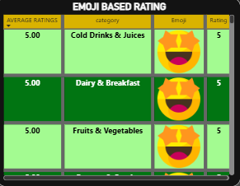
👶 21. Rated Product
1️⃣Insight:
Baby Care products show a wide spread of ratings from 1 to 4 stars.
Most ratings cluster around 2 and 3 stars, indicating mixed experiences.
2️⃣Observation:
Negative sentiment (1–2 stars) may reflect issues with product quality or expectations.
Investigate specific complaints to improve trust in this sensitive category

Slide 32
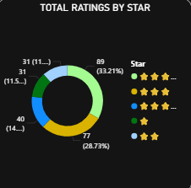
1️⃣Insight:
4-star ratings dominate (34.16%), followed by 5 stars (27.96%) and 3 stars (16.32%).
Only ~21% of ratings fall in the 1–2 star range.
2️⃣Observation:
Overall sentiment is positive, with over 60% of users rating 4 or 5 stars.
Maintaining consistency and addressing mid-tier feedback could push more users to 5 stars.
📊 37.Overall Ratings Breakdown

Slide 33
📦Key Findings :
1️⃣Robust Financial Health & Customer Base: Blinkit demonstrates strong financial performance with substantial total revenue and customer lifetime value. The customer base is well-segmented, with a healthy mix of regular, premium, and new customers.
2️⃣Seasonal Order Trends & Geographic Hotspots: Order volumes exhibit clear seasonal peaks (e.g., May, September), and demand is concentrated in specific pincodes within Asia. This highlights opportunities for optimized logistics and targeted marketing.
3️⃣Top-Selling Products & Categories: "Pet Treats" and household essentials like "Toilet Cleaner" are top-selling products by quantity, while "Dairy & Breakfast" is the leading revenue-generating category. This guides inventory and promotional strategies.
4️⃣Effective Marketing Campaigns & Conversion Opportunities: "App Push Notifications" and "Category Promotions" show exceptionally high ROAS, indicating successful campaign strategies. However, the overall campaign conversion rate (0.9%) suggests room for optimizing the post-click user journey.
5️⃣Inventory Management & Quality Control Needs: While current stock levels are healthy, high damaged stock percentages for certain perishable items (e.g., Bananas, Bread) point to a critical need for improved handling and storage protocols to reduce waste.

Slide 34
📌Conclusion
1️⃣Learnings: This project provided invaluable experience in end-to-end data analysis using Power BI, from data cleaning and transformation to creating insightful visualizations and deriving actionable business intelligence. It deepened my understanding of e-commerce operations, customer behavior, and the critical role of data in strategic decision-making.
2️⃣Impact on Decision-Making: The analysis offers Blinkit clear, data-driven insights that can significantly aid in decision-making:
Optimizing Marketing Spend: By identifying high-ROAS campaigns, Blinkit can reallocate budgets to maximize returns.
Improving Inventory Management: Insights into top-selling products, category revenue, and damaged stock percentages enable more efficient stocking and reduced waste.
Enhancing Customer Experience: Understanding customer segments, order patterns, and feedback details can lead to more personalized services and targeted improvements.
Strategic Expansion: Geographic order data can guide decisions on where to expand operations or focus delivery network enhancements.
Operational Efficiency: Analysis of delivery times and store performance can pinpoint areas for logistical improvements.
1️⃣Learnings: This project provided invaluable experience in end-to-end data analysis using Power BI, from data cleaning and transformation to creating insightful visualizations and deriving actionable business intelligence. It deepened my understanding of e-commerce operations, customer behavior, and the critical role of data in strategic decision-making.
2️⃣Impact on Decision-Making: The analysis offers Blinkit clear, data-driven insights that can significantly aid in decision-making:
Optimizing Marketing Spend: By identifying high-ROAS campaigns, Blinkit can reallocate budgets to maximize returns.
Improving Inventory Management: Insights into top-selling products, category revenue, and damaged stock percentages enable more efficient stocking and reduced waste.
Enhancing Customer Experience: Understanding customer segments, order patterns, and feedback details can lead to more personalized services and targeted improvements.
Strategic Expansion: Geographic order data can guide decisions on where to expand operations or focus delivery network enhancements.
Operational Efficiency: Analysis of delivery times and store performance can pinpoint areas for logistical improvements

Slide 35
📑References
1️⃣Dataset Source:
Kaggle - https://www.kaggle.com/datasets/akxiit/blinkit-sales-dataset/data
2️⃣Tools Documentation:
Power BI Documentation
GitHub Documentation

Slide 36
👨🏻‍💻GitHub Repository Link
You can find the Power BI report, dataset, and all related project files at the following GitHub repository:
https://github.com/arpitagit-hub/powerbi-blinkit-project

Slide 37
Thank You!

